Slide 1
CS 300- Operating Systems Introduction

Slide 2
What is an Operating System?
A program that acts as an intermediary between a user of a computer and the computer hardware
Operating system goals:
Execute user programs and make solving user problems easier
Make the computer system convenient to use
Use the computer hardware in an efficient manner

Slide 3
Computer System Structure
Computer system can be divided into four components:
Hardware – provides basic computing resources
CPU, memory, I/O devices
Operating system
Controls and coordinates use of hardware among various applications and users
Application programs – define the ways in which the system resources are used to solve the computing problems of the users
Word processors, compilers, web browsers, database systems, video games
Users
People, machines, other computers

Slide 4
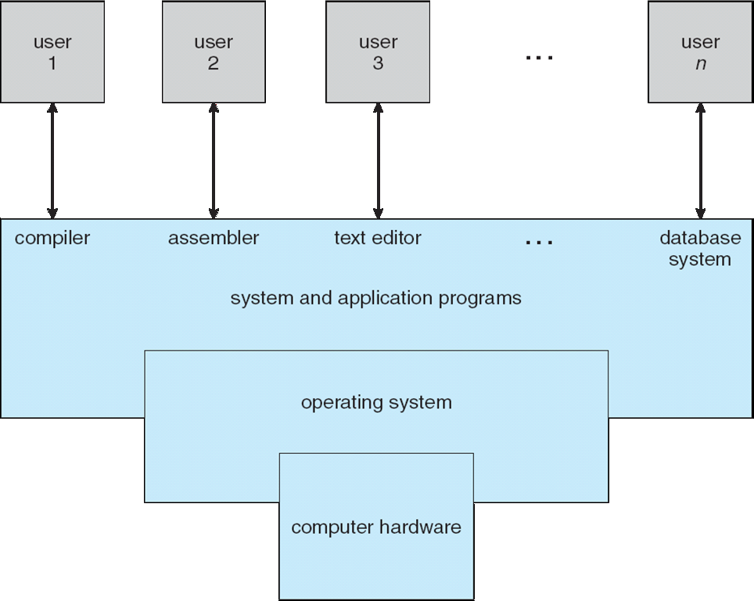
Four Components of a Computer System

Slide 5
What Operating Systems Do
Depends on the point of view
Users want convenience, ease of use and good performance
Don’t care about resource utilization
But shared computer such as mainframe or minicomputer must keep all users happy
Users of dedicate systems such as workstations have dedicated resources but frequently use shared resources from servers
Handheld computers are resource poor, optimized for usability and battery life
Some computers have little or no user interface, such as embedded computers in devices and automobiles

Slide 6
Operating System Definition
OS is a resource allocator
Manages all resources
Decides between conflicting requests for efficient and fair resource use
OS is a control program
Controls execution of programs to prevent errors and improper use of the computer

Slide 7
Operating System Definition (Cont.)
“The one program running at all times on the computer” is the kernel.
Everything else is either
a system program (ships with the operating system) , or
an application program

Slide 8
Computer Startup
bootstrap program is loaded at power-up or reboot
Typically stored in ROM or EPROM, generally known as firmware
Initializes all aspects of system from CPU registers to device controllers to memory contents
Loads operating system kernel and starts execution

Slide 9
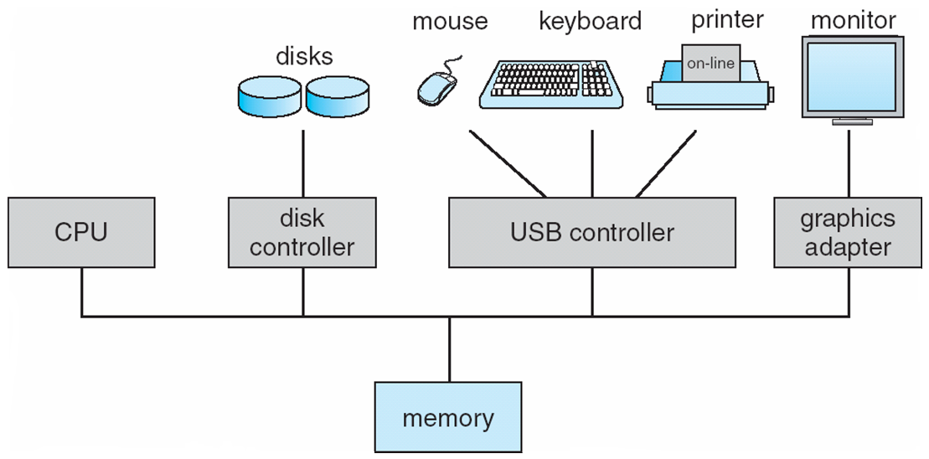
Computer System Organization
Computer-system operation
One or more CPUs, device controllers connect through common bus providing access to shared memory
Concurrent execution of CPUs and devices competing for memory cycles

Slide 10
Computer-System Operation
I/O devices and the CPU can execute concurrently
Each device controller is in charge of a particular device type
Each device controller has a local buffer
CPU moves data from/to main memory to/from local buffers
I/O is from the device to local buffer of controller
Device controller informs CPU that it has finished its operation by causing an interrupt

Slide 11
Common Functions of Interrupts
Interrupt transfers control to the interrupt service routine generally, through the interrupt vector, which contains the addresses of all the service routines
Interrupt architecture must save the address of the interrupted instruction
A trap or exception is a software-generated interrupt caused either by an error or a user request
An operating system is interrupt driven

Slide 12
Interrupt Handling
The operating system preserves the state of the CPU by storing registers and the program counter
Determines which type of interrupt has occurred:
polling
vectored interrupt system
Separate segments of code determine what action should be taken for each type of interrupt

Slide 13
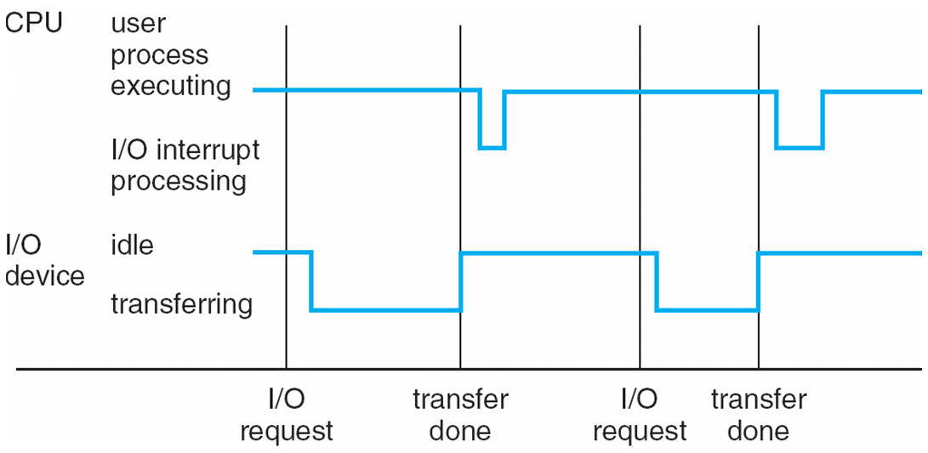
Interrupt Timeline

Slide 14
I/O Structure
After I/O starts, control returns to user program only upon I/O completion
Wait instruction idles the CPU until the next interrupt
Wait loop (contention for memory access)
At most one I/O request is outstanding at a time, no simultaneous I/O processing
After I/O starts, control returns to user program without waiting for I/O completion
System call – request to the OS to allow user to wait for I/O completion
Device-status table contains entry for each I/O device indicating its type, address, and state
OS indexes into I/O device table to determine device status and to modify table entry to include interrupt

Slide 15
Storage Structure
Main memory – only large storage media that the CPU can access directly
Random access
Typically volatile
Secondary storage – extension of main memory that provides large nonvolatile storage capacity
Hard disks – rigid metal or glass platters covered with magnetic recording material
Disk surface is logically divided into tracks, which are subdivided into sectors
The disk controller determines the logical interaction between the device and the computer
Solid-state disks – faster than hard disks, nonvolatile
Various technologies
Becoming more popular

Slide 16
Storage Hierarchy
Storage systems organized in hierarchy
Speed
Cost
Volatility
Caching – copying information into faster storage system; main memory can be viewed as a cache for secondary storage
Device Driver for each device controller to manage I/O
Provides uniform interface between controller and kernel

Slide 17
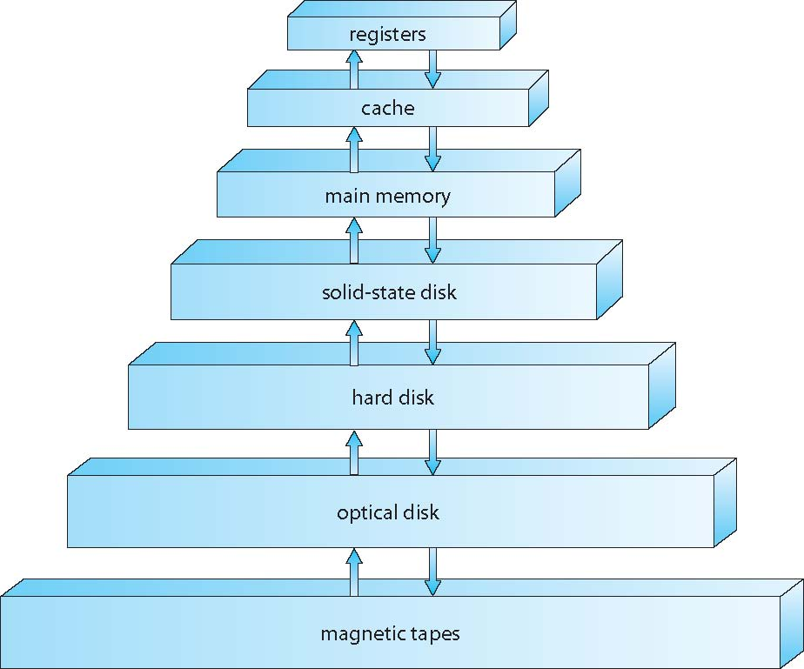
Storage-Device Hierarchy

Slide 18
Caching
Important principle, performed at many levels in a computer (in hardware, operating system, software)
Information in use copied from slower to faster storage temporarily
Faster storage (cache) checked first to determine if information is there
If it is, information used directly from the cache (fast)
If not, data copied to cache and used there
Cache smaller than storage being cached
Cache management important design problem
Cache size and replacement policy

Slide 19
Direct Memory Access Structure
Used for high-speed I/O devices able to transmit information at close to memory speeds
Device controller transfers blocks of data from buffer storage directly to main memory without CPU intervention
Only one interrupt is generated per block, rather than the one interrupt per byte

Slide 20
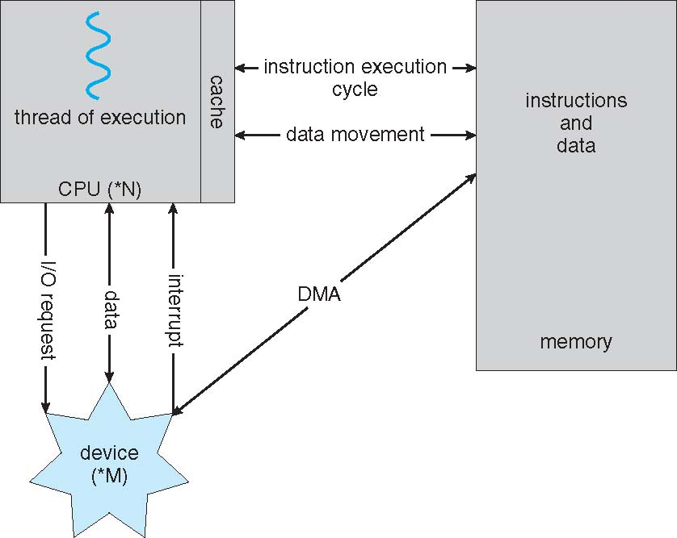
How a Modern Computer Works
A von Neumann architecture

Slide 21
Computer-System Architecture
Most systems use a single general-purpose processor
Most systems have special-purpose processors as well
Multiprocessors systems growing in use and importance
Also known as parallel systems, tightly-coupled systems
Advantages include:
Increased throughput
Economy of scale
Increased reliability – graceful degradation or fault tolerance
Two types:
Asymmetric Multiprocessing – each processor is assigned a special task.
Symmetric Multiprocessing – each processor performs all tasks

Slide 22
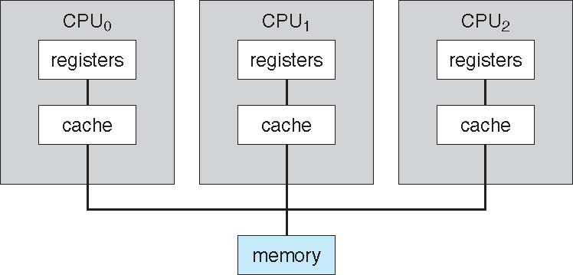
Symmetric Multiprocessing Architecture

Slide 23
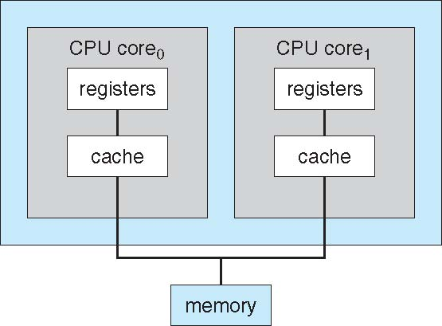
A Dual-Core Design
Multi-chip and multicore
Systems containing all chips
Chassis containing multiple separate systems

Slide 24
Clustered Systems
Like multiprocessor systems, but multiple systems working together
Usually sharing storage via a storage-area network (SAN)
Provides a high-availability service which survives failures
Asymmetric clustering has one machine in hot-standby mode
Symmetric clustering has multiple nodes running applications, monitoring each other
Some clusters are for high-performance computing (HPC)
Applications must be written to use parallelization
Some have distributed lock manager (DLM) to avoid conflicting operations

Slide 25
Clustered Systems

Slide 26
Operating System Structure
Multiprogramming (Batch system) needed for efficiency
Single user cannot keep CPU and I/O devices busy at all times
Multiprogramming organizes jobs (code and data) so CPU always has one to execute
A subset of total jobs in system is kept in memory
One job selected and run via job scheduling
When it has to wait (for I/O for example), OS switches to another job
Timesharing (multitasking) is logical extension in which CPU switches jobs so frequently that users can interact with each job while it is running, creating interactive computing
Response time should be < 1 second
Each user has at least one program executing in memory process
If several jobs ready to run at the same time  CPU scheduling
If processes don’t fit in memory, swapping moves them in and out to run
Virtual memory allows execution of processes not completely in memory

Slide 27
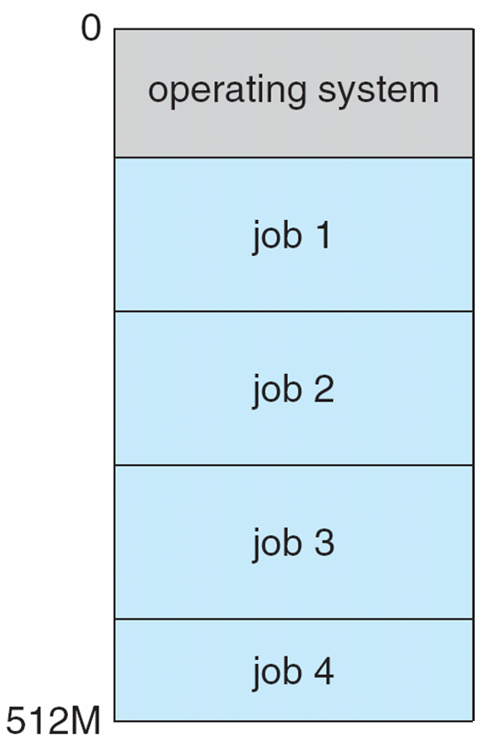
Memory Layout for Multiprogrammed System

Slide 28
Operating-System Operations
Interrupt driven (hardware and software)
Hardware interrupt by one of the devices
Software interrupt (exception or trap):
Software error (e.g., division by zero)
Request for operating system service
Other process problems include infinite loop, processes modifying each other or the operating system

Slide 29
Operating-System Operations (cont.)
Dual-mode operation allows OS to protect itself and other system components
User mode and kernel mode
Mode bit provided by hardware
Provides ability to distinguish when system is running user code or kernel code
Some instructions designated as privileged, only executable in kernel mode
System call changes mode to kernel, return from call resets it to user
Increasingly CPUs support multi-mode operations
i.e. virtual machine manager (VMM) mode for guest VMs

Slide 30
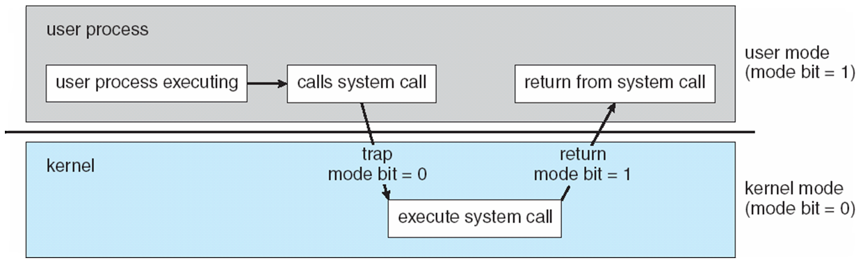
Transition from User to Kernel Mode
Timer to prevent infinite loop / process hogging resources
Timer is set to interrupt the computer after some time period
Keep a counter that is decremented by the physical clock.
Operating system set the counter (privileged instruction)
When counter zero generate an interrupt
Set up before scheduling process to regain control or terminate program that exceeds allotted time

Slide 31
Process Management
A process is a program in execution. It is a unit of work within the system. Program is a passive entity, process is an active entity.
Process needs resources to accomplish its task
CPU, memory, I/O, files
Initialization data
Process termination requires reclaim of any reusable resources
Single-threaded process has one program counter specifying location of next instruction to execute
Process executes instructions sequentially, one at a time, until completion
Multi-threaded process has one program counter per thread
Typically system has many processes, some user, some operating system running concurrently on one or more CPUs
Concurrency by multiplexing the CPUs among the processes / threads

Slide 32
Process Management Activities
The operating system is responsible for the following activities in connection with process management:
Creating and deleting both user and system processes
Suspending and resuming processes
Providing mechanisms for process synchronization
Providing mechanisms for process communication
Providing mechanisms for deadlock handling

Slide 33
Memory Management
To execute a program all (or part) of the instructions must be in memory
All (or part) of the data that is needed by the program must be in memory.
Memory management determines what is in memory and when
Optimizing CPU utilization and computer response to users
Memory management activities
Keeping track of which parts of memory are currently being used and by whom
Deciding which processes (or parts thereof) and data to move into and out of memory
Allocating and deallocating memory space as needed

Slide 34
Storage Management
OS provides uniform, logical view of information storage
Abstracts physical properties to logical storage unit - file
Each medium is controlled by device (i.e., disk drive, tape drive)
Varying properties include access speed, capacity, data-transfer rate, access method (sequential or random)
File-System management
Files usually organized into directories
Access control on most systems to determine who can access what
OS activities include
Creating and deleting files and directories
Primitives to manipulate files and directories
Mapping files onto secondary storage
Backup files onto stable (non-volatile) storage media

Slide 35
Mass-Storage Management
Usually disks used to store data that does not fit in main memory or data that must be kept for a “long” period of time
Proper management is of central importance
Entire speed of computer operation hinges on disk subsystem and its algorithms
OS activities
Free-space management
Storage allocation
Disk scheduling
Some storage need not be fast
Tertiary storage includes optical storage, magnetic tape
Still must be managed – by OS or applications
Varies between WORM (write-once, read-many-times) and RW (read-write)

Slide 36
Performance of Various Levels of Storage
Movement between levels of storage hierarchy can be explicit or implicit

Slide 37
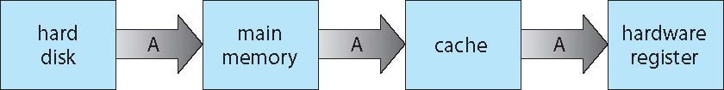
Migration of data “A” from Disk to Register
Multitasking environments must be careful to use most recent value, no matter where it is stored in the storage hierarchy
Multiprocessor environment must provide cache coherency in hardware such that all CPUs have the most recent value in their cache
Distributed environment situation even more complex
Several copies of a datum can exist

Slide 38
I/O Subsystem
One purpose of OS is to hide peculiarities of hardware devices from the user
I/O subsystem responsible for
Memory management of I/O including buffering (storing data temporarily while it is being transferred), caching (storing parts of data in faster storage for performance), spooling (the overlapping of output of one job with input of other jobs)
General device-driver interface
Drivers for specific hardware devices

Slide 39
Protection and Security
Protection – any mechanism for controlling access of processes or users to resources defined by the OS
Security – defense of the system against internal and external attacks
Huge range, including denial-of-service, worms, viruses, identity theft, theft of service
Systems generally first distinguish among users, to determine who can do what
User identities (user IDs, security IDs) include name and associated number, one per user
User ID then associated with all files, processes of that user to determine access control
Group identifier (group ID) allows set of users to be defined and controls managed, then also associated with each process, file
Privilege escalation allows user to change to effective ID with more rights

Slide 40
Kernel Data Structures
Many similar to standard programming data structures
Singly linked list
Doubly linked list
Circular linked list

Slide 41
Kernel Data Structures
Binary search tree left <= right
Search performance is O(n)
Balanced binary search tree is O(lg n)

Slide 42
Kernel Data Structures
Hash function can create a hash map
Bitmap – string of n binary digits representing the status of n items
Linux data structures defined in
include files <linux/list.h>, <linux/kfifo.h>, <linux/rbtree.h>

Slide 43
Operating System Services
Operating systems provide an environment for execution of programs and services to programs and users
User interface - Almost all operating systems have a user interface (UI).
Varies between Command-Line (CLI), Graphics User Interface (GUI), Batch
Program execution - The system must be able to load a program into memory and to run that program, end execution, either normally or abnormally (indicating error)
I/O operations - A running program may require I/O, which may involve a file or an I/O device

Slide 44
Operating System Services (Cont.)
File-system manipulation - Programs need to read and write files and directories, create and delete them, search them, list file Information, permission management.
Communications – Processes may exchange information, on the same computer or between computers over a network
Communications may be via shared memory or through message passing (packets moved by the OS)
Error detection – OS needs to be constantly aware of possible errors
May occur in the CPU and memory hardware, in I/O devices, in user program
For each type of error, OS should take the appropriate action to ensure correct and consistent computing
Debugging facilities can greatly enhance the user’s and programmer’s abilities to efficiently use the system

Slide 45
Operating System Services (Cont.)
Resource allocation - When multiple users or multiple jobs running concurrently, resources must be allocated to each of them
Resources - CPU cycles, main memory, file storage, I/O devices.
Accounting - To keep track of which users use how much and what kinds of computer resources
Protection and security - The owners of information stored in a multiuser or networked computer system may want to control use of that information, concurrent processes should not interfere with each other
Protection involves ensuring that all access to system resources is controlled
Security of the system from outsiders requires user authentication, extends to defending external I/O devices from invalid access attempts

Slide 46
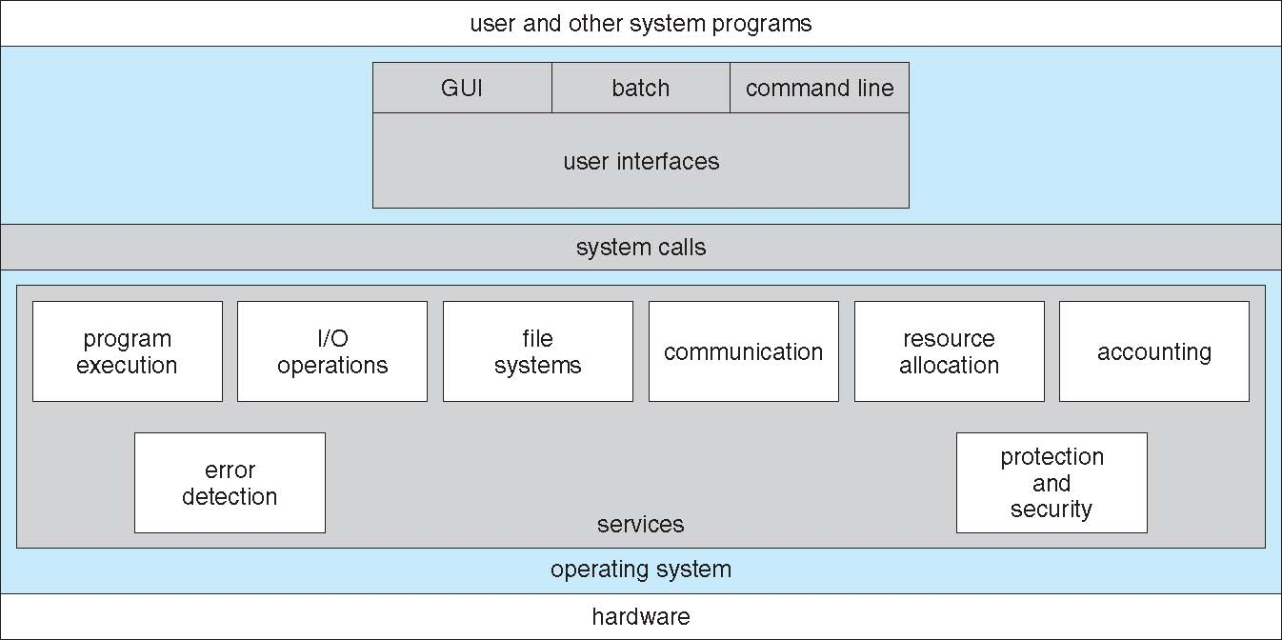
A View of Operating System Services

Slide 47
User Operating System Interface - CLI
CLI or command interpreter allows direct command entry
Sometimes implemented in kernel, sometimes by systems program
Sometimes multiple flavors implemented – shells
Primarily fetches a command from user and executes it
Sometimes commands built-in, sometimes just names of programs
If the latter, adding new features doesn’t require shell modification

Slide 48
User Operating System Interface - GUI
User-friendly desktop metaphor interface
Usually mouse, keyboard, and monitor
Icons represent files, programs, actions, etc
Various mouse buttons over objects in the interface cause various actions (provide information, options, execute function, open directory (known as a folder)
Invented at Xerox PARC
Many systems now include both CLI and GUI interfaces
Microsoft Windows is GUI with CLI “command” shell
Apple Mac OS X is “Aqua” GUI interface with UNIX kernel underneath and shells available
Unix and Linux have CLI with optional GUI interfaces (CDE, KDE, GNOME)

Slide 49
System Calls
Programming interface to the services provided by the OS
Typically written in a high-level language (C or C++)
Mostly accessed by programs via a high-level Application Programming Interface (API) rather than direct system call use
Three most common APIs are Win32 API for Windows, POSIX API for POSIX-based systems (including virtually all versions of UNIX, Linux, and Mac OS X), and Java API for the Java virtual machine (JVM)

Slide 50
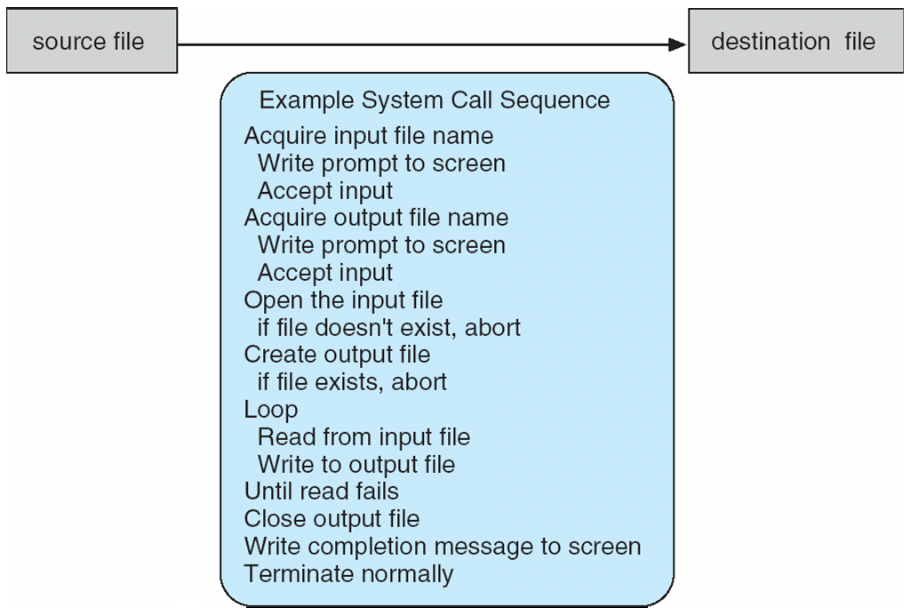
Example of System Calls
System call sequence to copy the contents of one file to another file

Slide 51
System Call Implementation
Typically, a number associated with each system call
System-call interface maintains a table indexed according to these numbers
The system call interface invokes the intended system call in OS kernel and returns status of the system call and any return values
The caller need know nothing about how the system call is implemented
Just needs to obey API and understand what OS will do as a result call
Most details of OS interface hidden from programmer by API
Managed by run-time support library (set of functions built into libraries included with compiler)

Slide 52
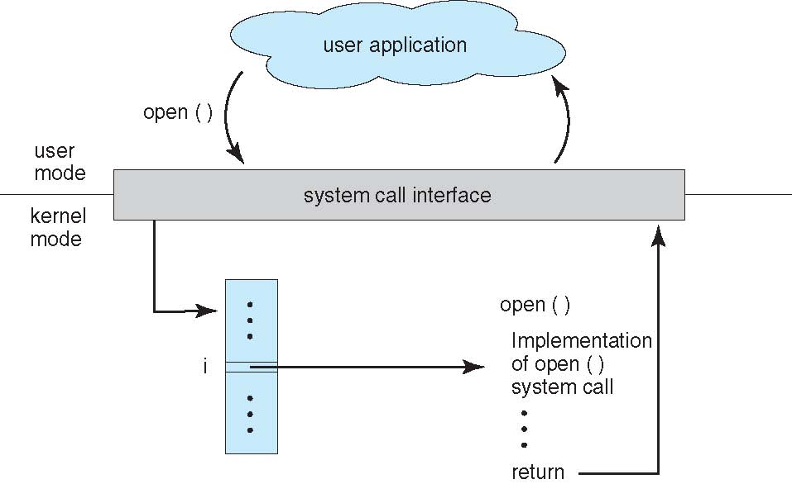
API – System Call – OS Relationship

Slide 53
System Call Parameter Passing
Often, more information is required than simply identity of desired system call
Exact type and amount of information vary according to OS and call
Three general methods used to pass parameters to the OS
Simplest: pass the parameters in registers
In some cases, may be more parameters than registers
Parameters stored in a block, or table, in memory, and address of block passed as a parameter in a register
This approach taken by Linux and Solaris
Parameters placed, or pushed, onto the stack by the program and popped off the stack by the operating system
Block and stack methods do not limit the number or length of parameters being passed

Slide 54
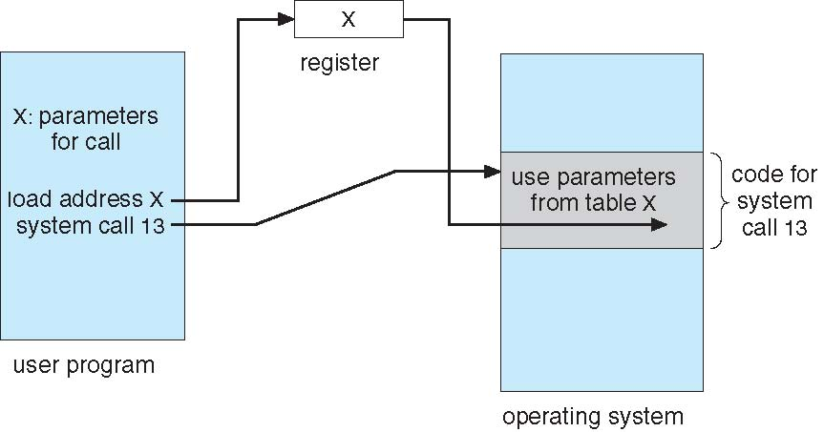
Parameter Passing via Table

Slide 55
Types of System Calls
Process control
create process, terminate process
end, abort
load, execute
get process attributes, set process attributes
wait for time
wait event, signal event
allocate and free memory
Dump memory if error
Debugger for determining bugs, single step execution
Locks for managing access to shared data between processes

Slide 56
Types of System Calls
File management
create file, delete file
open, close file
read, write, reposition
get and set file attributes
Device management
request device, release device
read, write, reposition
get device attributes, set device attributes
logically attach or detach devices

Slide 57
Types of System Calls (Cont.)
Information maintenance
get time or date, set time or date
get system data, set system data
get and set process, file, or device attributes
Communications
create, delete communication connection
send, receive messages if message passing model to host name or process name
From client to server
Shared-memory model create and gain access to memory regions
transfer status information
attach and detach remote devices

Slide 58
Types of System Calls (Cont.)
Protection
Control access to resources
Get and set permissions
Allow and deny user access

Slide 59
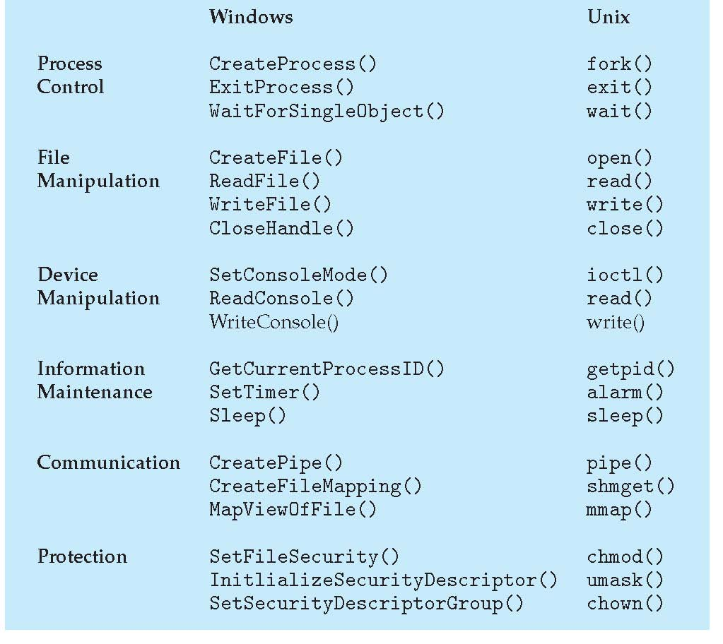
Examples of Windows and Unix System Calls

Slide 60
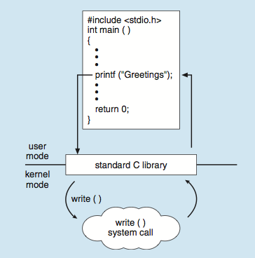
Standard C Library Example
C program invoking printf() library call, which calls write() system call

Slide 61
System Programs
System programs provide a convenient environment for program development and execution. They can be divided into:
File manipulation
Status information sometimes stored in a File modification
Programming language support
Program loading and execution
Communications
Background services
Application programs
Most users’ view of the operation system is defined by system programs, not the actual system calls

Slide 62
System Programs
Provide a convenient environment for program development and execution
Some of them are simply user interfaces to system calls; others are considerably more complex
File management - Create, delete, copy, rename, print, dump, list, and generally manipulate files and directories
Status information
Some ask the system for info - date, time, amount of available memory, disk space, number of users
Others provide detailed performance, logging, and debugging information
Typically, these programs format and print the output to the terminal or other output devices
Some systems implement a registry - used to store and retrieve configuration information

Slide 63
System Programs (Cont.)
File modification
Text editors to create and modify files
Special commands to search contents of files or perform transformations of the text
Programming-language support - Compilers, assemblers, debuggers and interpreters sometimes provided
Program loading and execution- Absolute loaders, relocatable loaders, linkage editors, and overlay-loaders, debugging systems for higher-level and machine language
Communications - Provide the mechanism for creating virtual connections among processes, users, and computer systems
Allow users to send messages to one another’s screens, browse web pages, send electronic-mail messages, log in remotely, transfer files from one machine to another

Slide 64
System Programs (Cont.)
Background Services
Launch at boot time
Some for system startup, then terminate
Some from system boot to shutdown
Provide facilities like disk checking, process scheduling, error logging, printing
Run in user context not kernel context
Known as services, subsystems, daemons
Application programs
Don’t pertain to system
Run by users
Not typically considered part of OS
Launched by command line, mouse click, finger poke

Slide 65
Operating System Design and Implementation
Design and Implementation of OS not “solvable”, but some approaches have proven successful
Internal structure of different Operating Systems can vary widely
Start the design by defining goals and specifications
Affected by choice of hardware, type of system
User goals and System goals
User goals – operating system should be convenient to use, easy to learn, reliable, safe, and fast
System goals – operating system should be easy to design, implement, and maintain, as well as flexible, reliable, error-free, and efficient

Slide 66
Operating System Design and Implementation (Cont.)
Important principle to separate
Policy: What will be done? Mechanism: How to do it?
Mechanisms determine how to do something, policies decide what will be done
The separation of policy from mechanism is a very important principle, it allows maximum flexibility if policy decisions are to be changed later (example – timer)
Specifying and designing an OS is highly creative task of software engineering

Slide 67
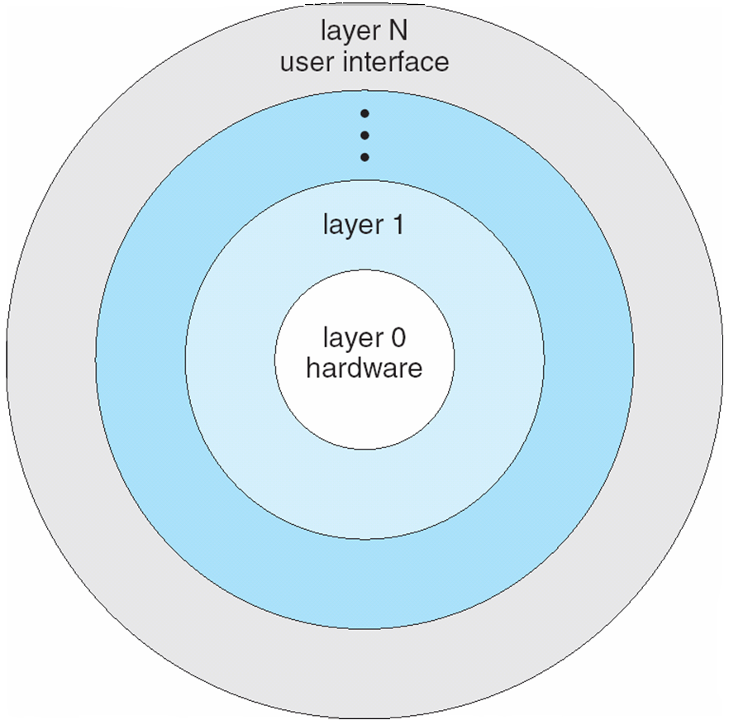
Layered Approach
The operating system is divided into a number of layers (levels), each built on top of lower layers. The bottom layer (layer 0), is the hardware; the highest (layer N) is the user interface.
With modularity, layers are selected such that each uses functions (operations) and services of only lower-level layers

Slide 68
Operating-System Debugging
Debugging is finding and fixing errors, or bugs
OS generate log files containing error information
Failure of an application can generate core dump file capturing memory of the process
Operating system failure can generate crash dump file containing kernel memory
Beyond crashes, performance tuning can optimize system performance
Sometimes using trace listings of activities, recorded for analysis
Profiling is periodic sampling of instruction pointer to look for statistical trends
Kernighan’s Law: “Debugging is twice as hard as writing the code in the first place. Therefore, if you write the code as cleverly as possible, you are, by definition, not smart enough to debug it.”

Slide 69
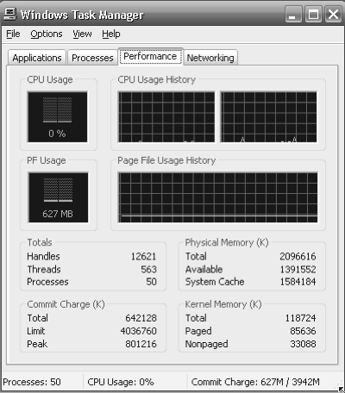
Performance Tuning
Improve performance by removing bottlenecks
OS must provide means of computing and displaying measures of system behavior
For example, “top” program or Windows Task Manager

Slide 70
System Boot
When power initialized on system, execution starts at a fixed memory location
Firmware ROM used to hold initial boot code
Operating system must be made available to hardware so hardware can start it
Small piece of code – bootstrap loader, stored in ROM or EEPROM locates the kernel, loads it into memory, and starts it
Sometimes two-step process where boot block at fixed location loaded by ROM code, which loads bootstrap loader from disk
Common bootstrap loader, GRUB, allows selection of kernel from multiple disks, versions, kernel options
Kernel loads and system is then running

